Slide 1


FirstNet Consultation Prep Pack
FirstNet Basics
About Consultation
This package contains information that will be helpful in preparing for the FirstNet consultation meeting to occur
July 29th, 2014
The First 3 Sections are geared to all participants
The Next Two Sections are more Technical
The Last Section is Policy and Finance
Need for FirstNet
LTE Basics
Coverage Work
PPP Possibilities

Slide 2

Maryland is the FIRST State to have our Initial Consultation
STATE
It will be a learning experience for both us and FirstNet
We have a chance to shape how these deliberations happen in the future
Let’s use this opportunity to be patient and provide suggestions for improvement
No one knows everything about building this once in a lifetime critical network. Not FirstNet and not the States. But together we can define the public safety user requirements and that’s what this consultation is focused on. Tell us (and FirstNet) what you need to make this a valuable tool.

Slide 3
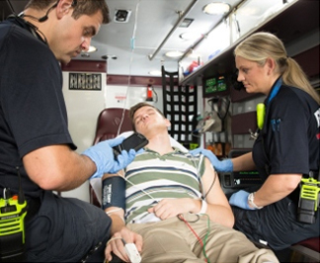
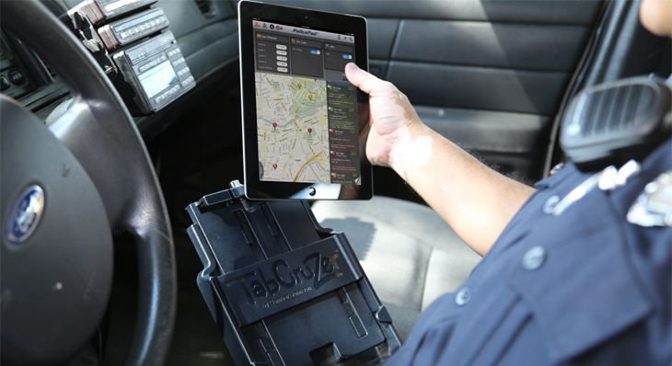
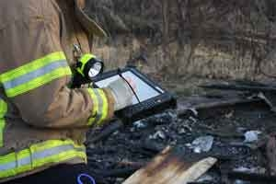
FirstNet Basics
Mission & Vision: Provide emergency responders with the first nationwide, high-speed, wireless broadband network dedicated to public safety.

Slide 4


FirstNet Basics
≠
LMR
Voice network
State program
Planning stage
Federal program
Data network
LTE
Implementation stage
Experts agree it will be a decade or more before LMR and Broadband will be able to be provided on a single network/device.

Slide 5
FirstNet Basics
Maintaining Land Mobile Radio (LMR)
Public safety’s use of LMR systems will continue for the foreseeable future. There is no defined timeframe when long term evolution (LTE) broadband technology may provide the same level of mission-critical voice services that are available today or if voice services will be incorporated in the NPSBN.
 | Land Mobile Radio (LMR) | Long Term Evolution (LTE)
Definition | LMR is a land-based wireless narrowband communications system commonly used by Federal, State, and local emergency responders, governments at all levels, commercial companies, and the military to support voice and low-speed data communications | LTE is the next evolution of commercial broadband wireless communications technology, initially developed to address the demand for high-speed, data intensive communications. This aids public safety officials in improving situational awareness, advanced analytics, database lookups, and video applications
Continued LMR Investment
It will be necessary to continue investments for existing and new LMR voice systems, while allocating new funding to the development and deployment of the NPSBN
NPSBN does not replace LMR
Currently, the available broadband technologies do not adequately support voice communications capabilities as required by public safety personnel

Slide 6
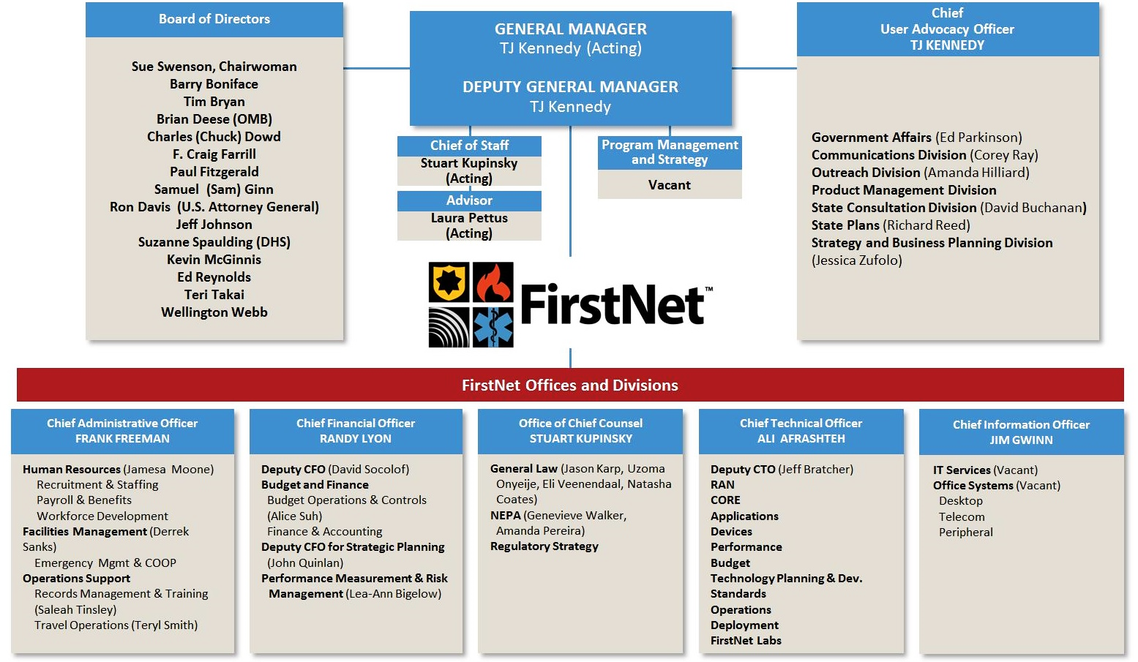
FirstNet Basics
ATTENDING JULY 29TH
FirstNet Organizational Chart
For more on governance, see: http://firstnet.gov/
Notes:
For more on governance, see: http://firstnet.gov/

Slide 7
FirstNet Basics
History and the Act…
FirstNet was created by Title VI of the Middle Class Tax Relief Act of 2012.
Allocated Spectrum
Allocated the “D-Block” to public safety
Added 20MHz to existing Public Safety Frequencies
Established Governance
Created the FirstNet Board
Secured Funding
$7B for deployment and operations
$135M for state implementation planning

Slide 8
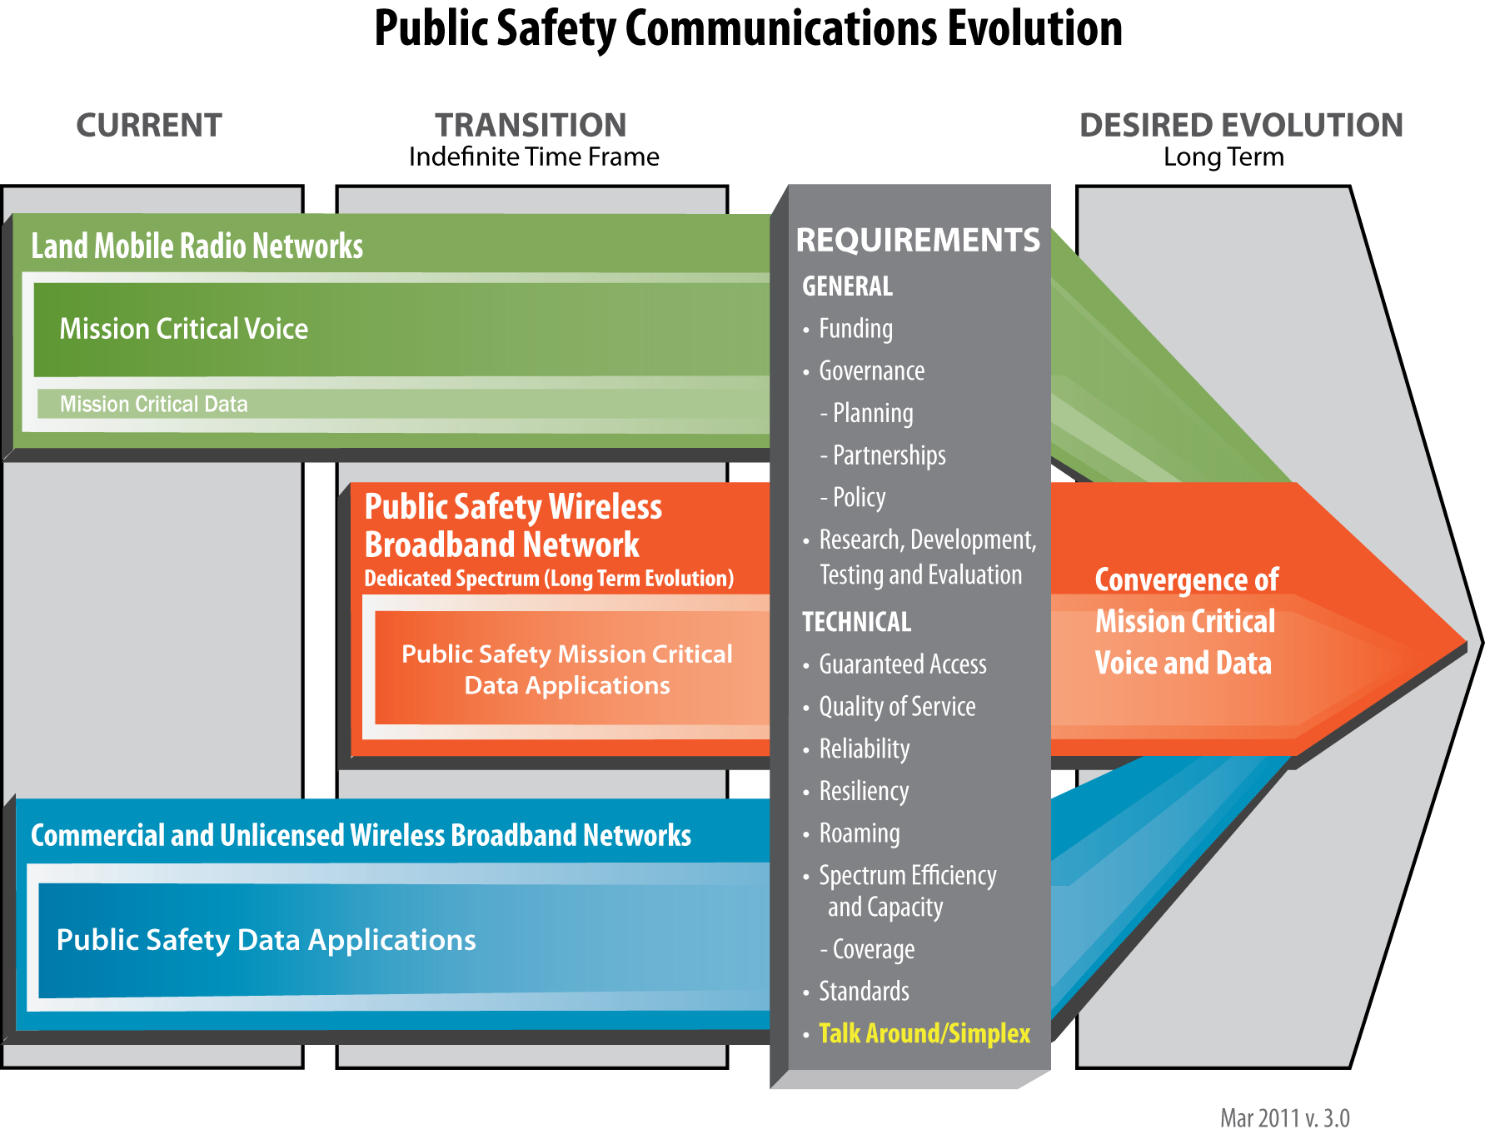
FirstNet Basics
The Evolution of Emergency Communications
Notes:
For more, see: https://mdinterop-public.sharepoint.com/vision.

Slide 9
FirstNet Basics
MD is working to be a national leader in FirstNet Outreach
1000+ Stakeholders reached
Hosted FEMA coverage workshop
3 regional technology forums
200+ attendees
Established a website, used as the national depository for FirstNet resources
1500+ page views since April
Twitter @MDInterOP
200+ followers
LinkedIn
National Timeline
Outreach
Data Collection
MD has completed its Initial Consultation Package for FirstNet
MD has created a state-of-the-art survey tool to collect Stakeholder data
We are Here
Network Design
Referred to as “Consultation”
Iterative Process
In MD – Begins July 29, 2014
Offer to Governor
Rollout
Operations
2014
2015
…

Slide 10
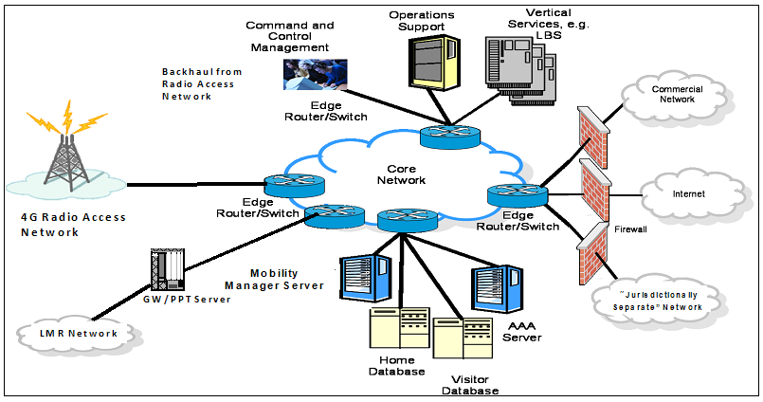

About Consultation
About Consultation
Key Points:
FirstNet will be designing a
Radio Access Network (RAN) that
Maryland will use to connect to the FirstNet Core(s).
This RAN plan will be delivered to the Governor, who will make a final decision on whether Maryland will adopt the FirstNet plan (“opting in”), or submit an alternative state RAN plan proposal to FirstNet (“opting out”)
The law requires FirstNet to consult with states to gather the information needed to develop the RAN plan.
A fruitful consultation process will yield a good RAN design for Maryland.
For more on the consultation process, see: https://mdinterop-public.sharepoint.com/process.
For more on the consultation process, see: https://mdinterop-public.sharepoint.com/process.

Slide 11
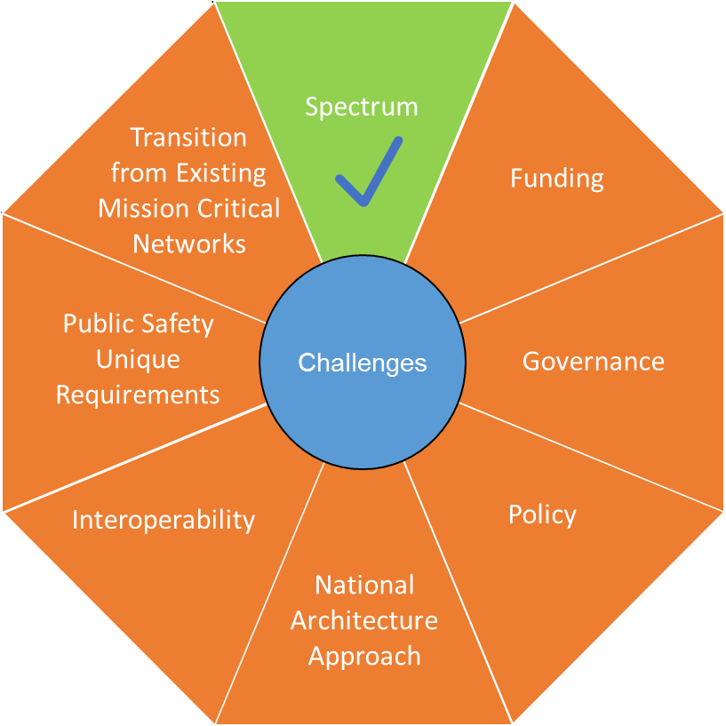
About Consultation
Challenges Facing FirstNet
Image courtesy of Department of Homeland Security, OEC. For more, see http://www.dhs.gov/about-office-emergency-communications
For more on the consultation process, see: https://mdinterop-public.sharepoint.com/process.

Slide 12
About Consultation
About Consultation
Requirements Planning
Stakeholder Decisions
Contracts & Core Network Completion
Deployment & Operations
Multiple Step
Process
July 29th is Step 1
For more on the consultation process, see: https://mdinterop-public.sharepoint.com/process.

Slide 13
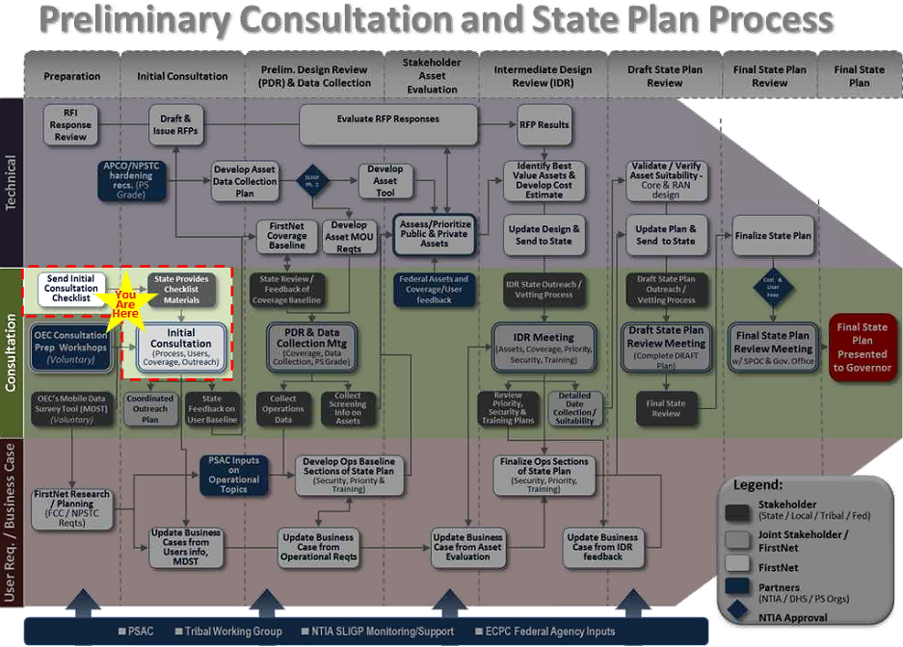
About Consultation
Where Does Consultation Fit in the Overall FirstNet Plan?
Initial consultation is one of the first steps in the state planning process. This process will be iterative – meaning that the initial consultation meeting will begin a lengthy discussion that will take place between Maryland stakeholders and FirstNet over course of the next year(s).
For more on the consultation process, see: https://mdinterop-public.sharepoint.com/process.

Slide 14
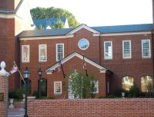
About Consultation
First Step for FirstNet?
Initial Consultation Meeting
Date: July 29th, 2014
Place: Miller Senate Office Building West
11 Bladen Street
Annapolis, MD 21401

Slide 15
About Consultation
Meeting Attendees
FirstNet Attendees:
FirstNet will be sending a large, diverse contingent to the meeting. Attendees will include policy experts, those with technical expertise and network engineers.
Maryland Attendees
Maryland will be sending senior leadership from the following entities:
Office of the Governor
Maryland State Police
Maryland Emergency Management Agency
Maryland Institute for Emergency Medical Services Systems
Department of Natural Resources & Maritime Law Enforcement Information Network
Department of Information Technology
Department of Public Safety and Correctional Services
There will also be a group of local and regional representatives in attendance.

Slide 16
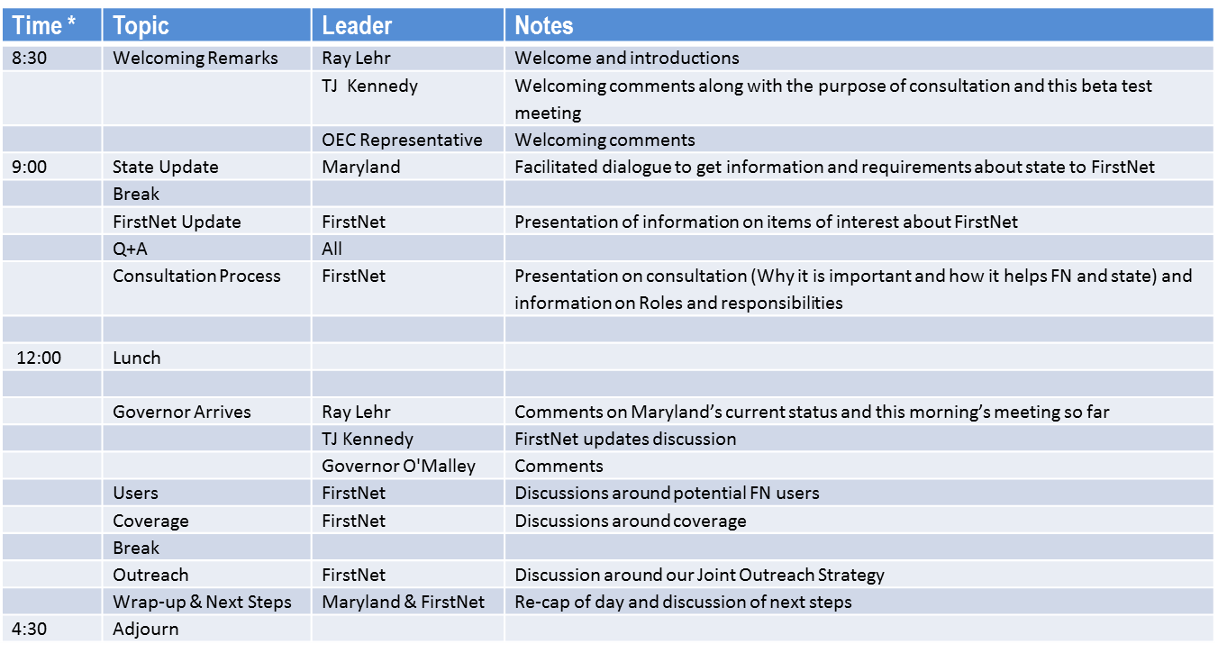
About Consultation
Initial Consultation Meeting Agenda
* Note that specific times are not listed as we want to allow for an open dialog as necessary

Slide 17
About Consultation
Initial Consultation Meeting Goals
Receive project update from FirstNet leadership
Start laying out requirements for Maryland’s RAN
Gain better understanding of data to be collected to support RAN design process
Gain better understanding on project timelines, and milestones
Help FirstNet refine the process for other States and territories

Slide 18
About Consultation
What to Bring to the July 29 meeting:
An open attitude. This is the very first consultation meeting, and FirstNet does not yet have all of the answers to the key questions.
You do NOT need to bring any information about your current data usage, required inventories, detailed costs of your current service, etc. We will be discussing this information with you in depth as the consultation process continues.

Slide 19
About Consultation
Come Ready to Discuss
1. What mission critical data services do you currently use and for what purpose?
Example: Use of personal commercial devices to view OSPREY, WebEOC, or CAD-RMS.
2. What are the key faults or limitations with regards to your current data usage?
Examples:
i. commercial network failure during high-volume events or severe weather events
ii. devices are not hardened for first responder use
iii. no interoperability.
3. What mission critical capabilities would you want from FirstNet?
Examples:
i. live video
ii. GIS mapping
iii. instant access to suspect profiles
4. What are your key questions/concerns regarding the implementation of FirstNet in Maryland?
Examples:
i. cost of building and maintaining the network
ii. cost of access to the network
iii. security concerns

Slide 20
About Consultation
Advance Preparation Webinars
Two webinars will be conducted prior to the consultation meeting on July 29th
They are voluntary, but will provide a thorough overview of what to expect
Dates:
Thursday 7/24/2014 @ 4:00-4:15 PM https://attendee.gotowebinar.com/register/8178010617092187137
Friday 7/25/2014 @ 10:00-10:15 AM https://attendee.gotowebinar.com/register/8178010617092187137

Slide 21




3G/ Voice-over LTE
Need for FirstNet
CAD
RMS
Video
AVL
etc.
Public Safety LMR
Commercial Networks
Current State:
Public Safety Competes with Public for Priority
Mission Critical
MDT / Laptop
Radio
Non-Mission Critical
For more, see: https://mdinterop-public.sharepoint.com/

Slide 22
3G/ Voice-over LTE
Need for FirstNet
CAD
RMS
Video
AVL
etc.
Public Safety LMR
FirstNet
With FirstNet:
Dedicated Public Safety Grade Network
Mission Critical
MDT / Laptop
Radio
Non-Mission Critical
For more, see: https://mdinterop-public.sharepoint.com/

Slide 23
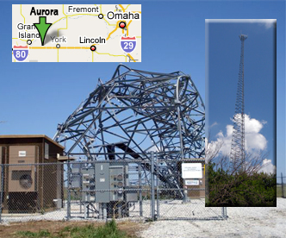
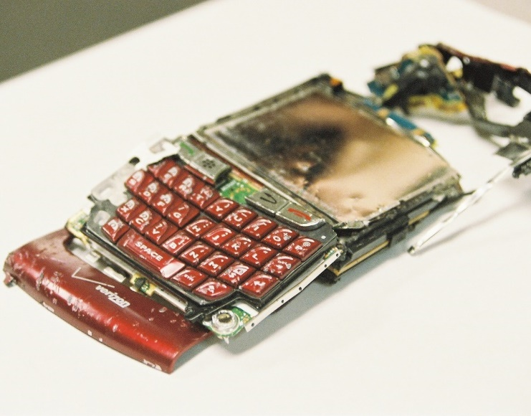
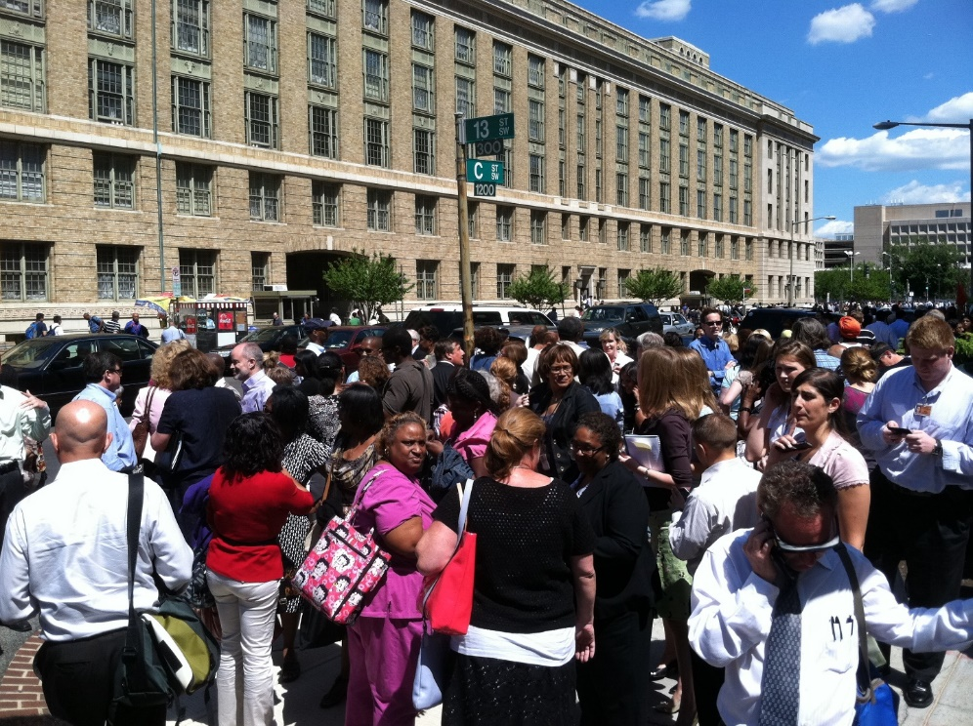
Need for FirstNet
Public Safety Cannot Rely on Commercial Networks
Commercial Network fail during severe weather events
Commercial Networks can become overwhelmed in an emergency
Commercial Devices are not hardened

Slide 24

Need for FirstNet
There Should be an App for that…
FirstNet will create an App Marketplace that will allow entrepreneurs to bring state-of-the-art technology to public safety.
For more, see: https://mdinterop-public.sharepoint.com/

Slide 25
LTE Basics
Coverage and capacity
LTE v. LMR – Key Differences
Data vs. Voice
LTE is a data network. Mission critical voice will remain on LMR.
Site Density
LTE technology requires a higher tower site density than LMR. The coverage ratio is roughly 1:5, but this can vary greatly depending on the location.
All Digital
IP packet based network, from device all the way through. This ensures seamless interoperability.
Standards Based
LTE standards make devices cheaper, more commercially available, and more interoperable nationally and internationally. – BUT LTE standards will need to evolve to help meet public safety needs.
For more, see: https://mdinterop-public.sharepoint.com/

Slide 26
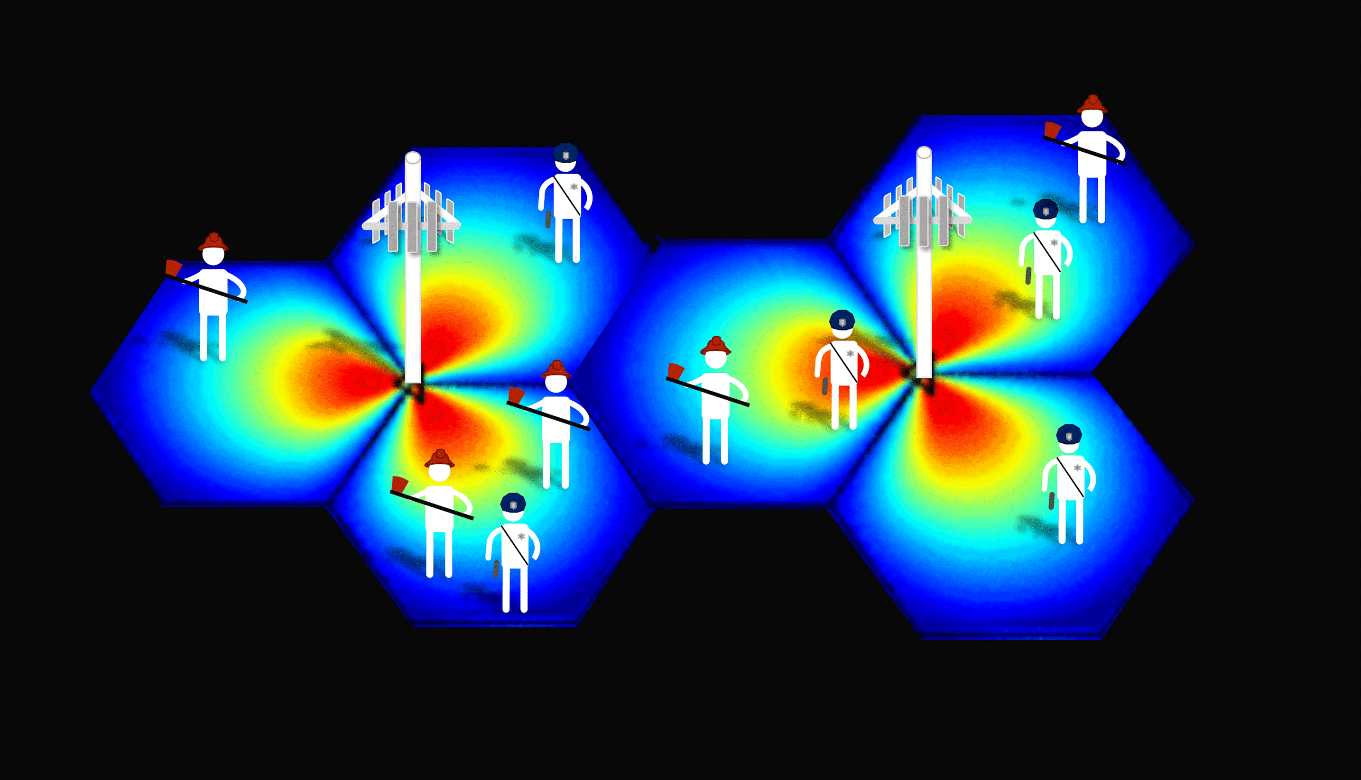

LTE Basics
Pre-emption
FirstNet will be built to fit the needs of first responders.
Because the Act granted more spectrum than public safety would need in the absence of an emergency event, it is possible that FirstNet will auction off spectrum to secondary users. We don’t yet know who these users will be and what the process will look like.
However, as soon as an emergency event occurs, LTE has the technical capability to ruthlessly preempt secondary users and make the network available solely to First Responders.
For more, see: https://mdinterop-public.sharepoint.com/

Slide 27
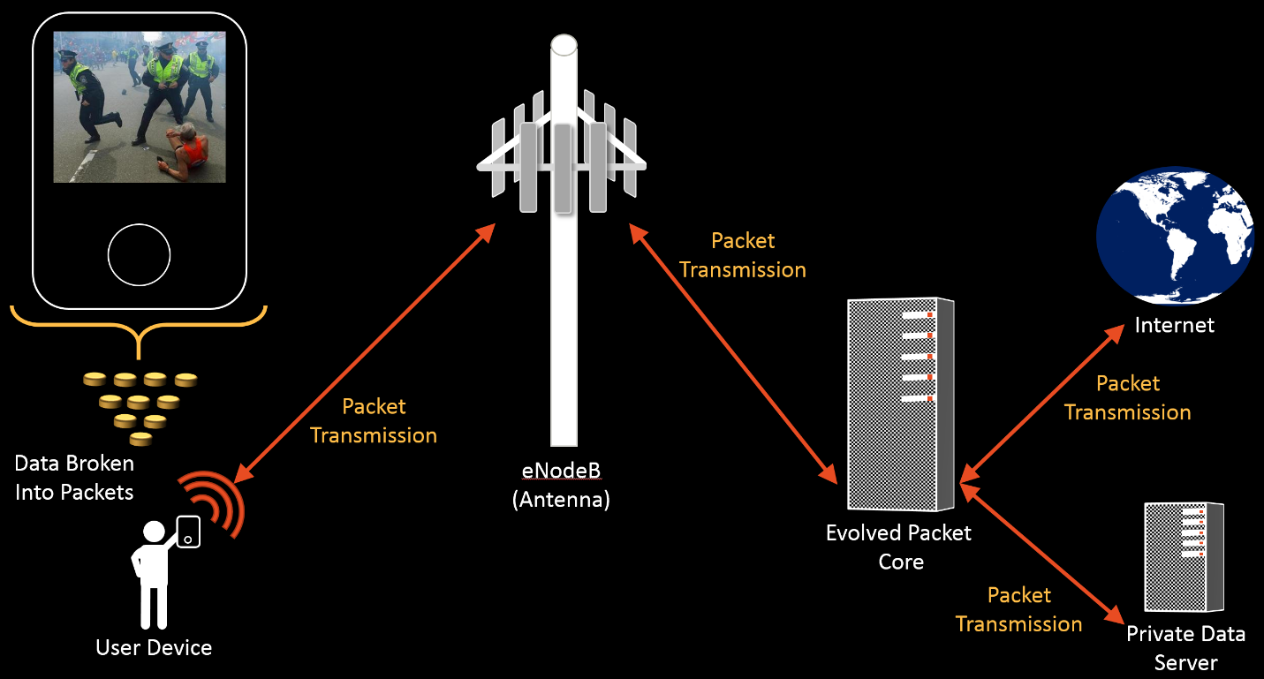







LTE Basics
LTE Architecture
Digital packets are transmitted from the users (often referred to as "UEs") over the air to an LTE antenna ("eNodeB"), which conveys those packets to an evolved packet core (EPC) that handles the routing of those packets to their destination. Once digital packets reach their destination, they are collected and used to rebuild the original data.
Core (EPC)
Radio Sites (RAN)
User Equip. (UE)
Internet, Intranets, commercial carriers, etc.
External
Networks
eNodeB
Significant Backhaul Requirements
For more, see: https://mdinterop-public.sharepoint.com/

Slide 28
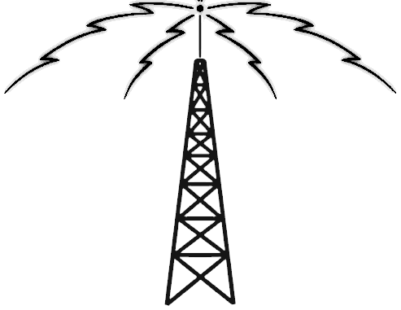
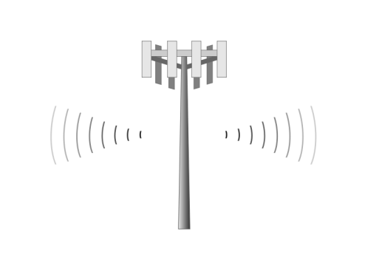
LTE Basics
LMR
LTE
Channels pre-configured per site
Overlapping coverage using different frequency
Fixed bandwidth / throughput per channel
Users on one channel don’t impact others
All sites (sectors) operate on same frequency thus overlapping coverage needs to be minimized
“Channels” (slots) managed dynamically at each site
Bandwidth determined by need and availability
Number of users at a site can impact coverage
LMR vs. LTE Capacity
LMR Spectrum
LTE Spectrum
Modeling to predict performance is not easy and difficult to compare
Sector 3
Sector 2
For more, see: https://mdinterop-public.sharepoint.com/
Sector 1

Slide 29
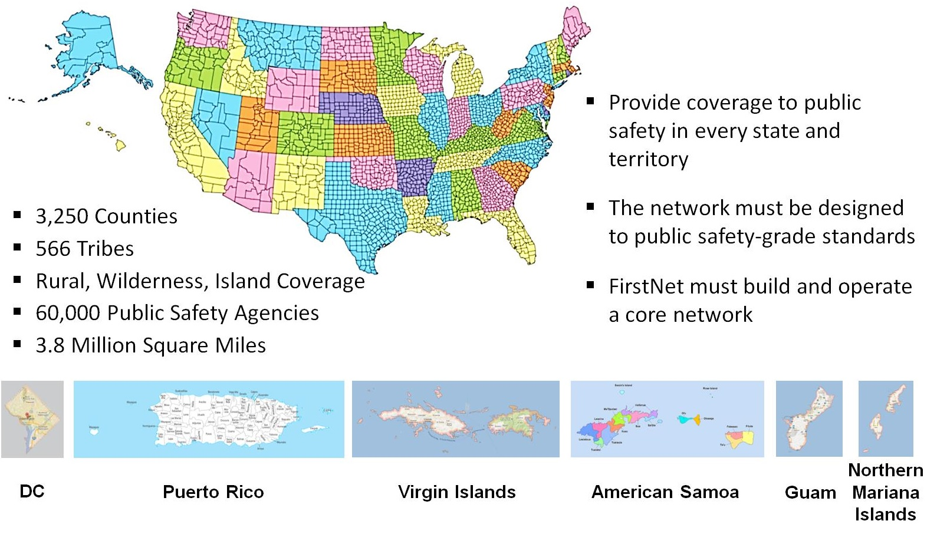
Coverage Work
Nationwide Coverage Challenge

Slide 30
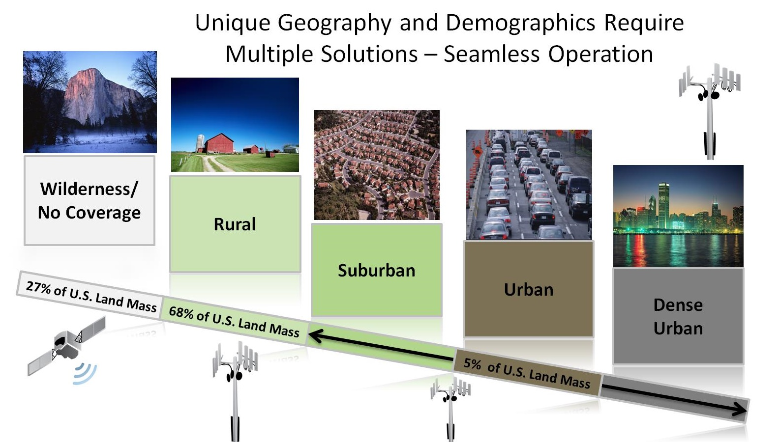
Coverage Work
Unique Coverage Categories

Slide 31


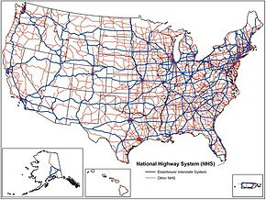

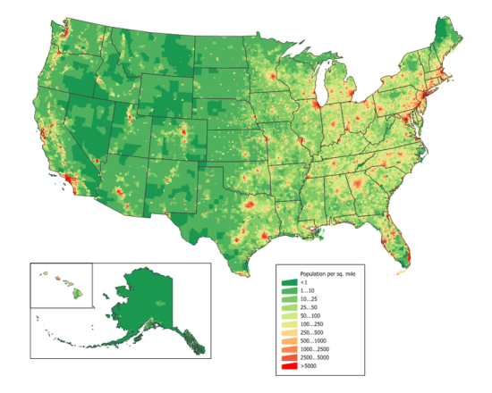
Coverage Work
Previous Work:
Broadband Consultation Prep Workshop
October 16, 2013
Objective: help states with a starting point of data that can be considered when establishing coverage objectives for FirstNet
OEC has gathered a variety of nationwide data from several sources to establish a baseline
OEC has coordinated our baseline with FirstNet to ensure it’s a reasonable starting point
States/Territories can then tailor it to unique Public Safety operational needs
Population Density

Slide 32
What we know
What we don’t know
Next Steps?
$7B will not be enough to launch FirstNet nationally
On an average day, it is unlikely public safety will use all of the available spectrum
Excess capacity is highly valuable
Whether a national or regional PPP will come to life
A PPP could be a perfect way to bring together private equity industry, the Federal government, and local public safety
Who potential PPP partners might be
How, or if, excess capacity will be monetized
FirstNet will provide greater clarity and guidance on the national PPP plan
RFPs will help better define possible PPP arrangements
Maryland will continue to consider PPPs at the state, regional, and national levels
PPP Possibilities
Public Private Partnership Possibilities

Slide 33
PPP Possibilities
Utility
Share infrastructure and maybe spectrum
Carrier
Share infrastructure and maybe spectrum
Utility workers and devices become network subscribers, use excess capacity
Commercial carrier subscribers roam onto network, use excess capacity
Public-Private Partnership (PPP)
Various Structures and Many potential partners…
Users
States
PPP Entity
Deployment Contractors
OM&R Contractors
Private Investors

Slide 34
Business Model
1) Monetizing
2) Financing
3) Ownership
How best to realize the value of the public safety network?
Who provides the funds to build and operate the network?
Who owns the network assets?
PPP Possibilities
3 Major Issues

Slide 35
PPP Possibilities
FirstNet Money (from $7B)
Private Investors
Upfront $$$
Vendors or Carriers
State/Local Contributions
Upfront Investment

Slide 36
PPP Possibilities
PS Subscriber Monthly Fees
Ongoing Revenue
$0
$??
Challenge:
Identify the maximum subscriber fee level(s) that will drive—or at least not harm—adoption of the network by primary and secondary users?

Slide 37
PPP Possibilities
Own From Beginning
Own At End
Deep Integration (Don’t own at all?)
Ownership Possibilities
Question:
Ownership is an asset for investors; depending on the option selected, Maryland could own some or all of the network assets.

Slide 38
PPP Possibilities
Many Flexible Approaches
Maryland is Well-Suited
FirstNet Engagement Critical
Key Public Private Partnership Takeaways

Slide 39
FirstNet Consultation Prep Pack
Prepared by Maryland Interoperability Team.
info@mdinterop.onmicrosoft.com
https://mdinterop-public.sharepoint.com/
Twitter: @MDInterOp

Slide 40
Disclaimer
This slide deck was prepared by the Maryland Department of Information Technology using funds under award 24-10-S13024 from the National Telecommunications and Information Administration (NTIA), U.S. Department of Commerce (DOC). The statements, findings, conclusions, and recommendations are those of the author(s) and do not necessarily reflect the views of the NTIA, DOC, or FirstNet.
Notes:
Max

